Slide 1
Customer Spending Score Prediction using Random Forest Algorithm
Halil Kılcı
21501317

Slide 2
Problem Definition
This project aims to develop a machine learning model to predict customer spending scores. Customer spending score is a value calculated based on customers' past purchase data, demographic information, and other factors.
Understanding customer behavior and predicting spending habits are of great importance for businesses to make strategic decisions and optimize marketing activities. The goal of this project is to provide businesses with a valuable tool for understanding customer behavior and predicting spending habits.

Slide 3
Dataset
The dataset used in this project is called the "Mall Customers Dataset." It provides valuable information about customers' demographics and their corresponding spending scores. The dataset is obtained from;
https://www.kaggle.com/datasets/vjchoudhary7/customer-segmentation-tutorial-in-python

Slide 4
Dataset
Data Structure and Content:
The Mall Customers Dataset consists of several features that help understand customer behavior and predict their spending scores. The features include:
CustomerID: Unique identifier for each customer.
Gender: The gender of the customer.
Age: The age of the customer.
Annual Income: The annual income of the customer.
Spending Score: A score representing the customer's spending behavior.

Slide 5
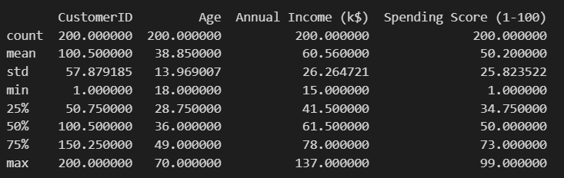
dataset

Slide 6
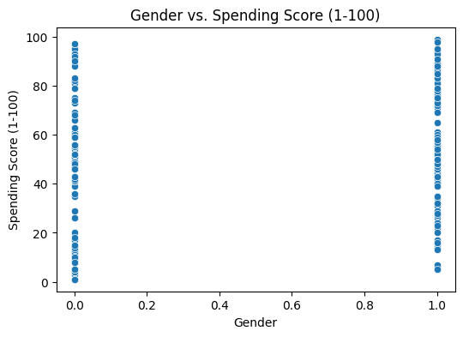
Dataset Visualizations

Slide 7
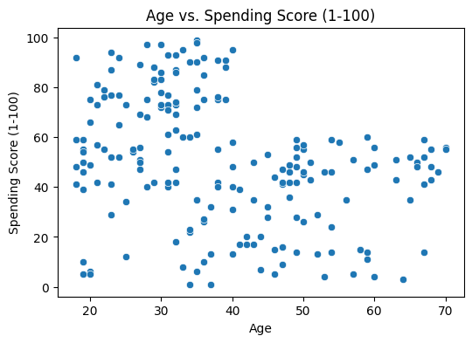
Dataset Visualizations

Slide 8
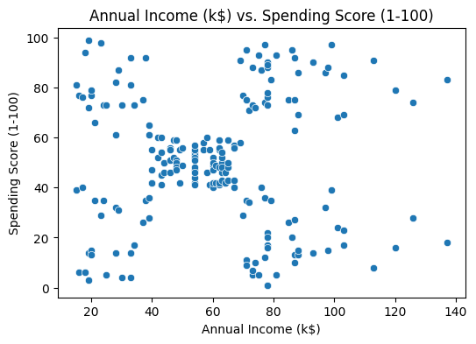
Dataset Visualizations

Slide 9
Machine Learning Model
In this project, we employed the Random Forest algorithm as our machine learning model to predict customer spending scores. Random Forest was chosen due to its effectiveness in handling complex datasets and its ability to provide robust predictions.
Random Forest is an ensemble learning algorithm that combines multiple decision trees to make predictions. It operates by creating a multitude of decision trees during the training phase and averaging their predictions during the testing phase. Each decision tree is constructed based on a random subset of features and a random subset of training samples. By aggregating the predictions of multiple trees, Random Forest can reduce overfitting and improve generalization.

Slide 10
Machine Learning Model
Advantages of Random Forest:
High Accuracy: Random Forest tends to provide accurate predictions by aggregating the outputs of multiple decision trees.
Robustness to Outliers: Random Forest is less sensitive to outliers compared to other algorithms, making it suitable for datasets with noisy or incomplete data.
Feature Importance: The algorithm can measure the importance of each feature, allowing us to identify the key factors that contribute to customer spending scores.
Handling of Large Datasets: Random Forest can efficiently handle datasets with a large number of features and instances.

Slide 11
Machine Learning Model
Training and Prediction:
To train the Random Forest model, we utilized the labeled dataset consisting of historical customer data and their corresponding spending scores. The dataset was split into training and testing sets, with the training set used to build the ensemble of decision trees. During the prediction phase, the trained model takes the relevant customer features as input and generates a predicted spending score as output.
By employing the Random Forest algorithm, we achieved reliable predictions of customer spending scores, enabling businesses to gain insights into customer behavior and make informed decisions.

Slide 12
Results
The Random Forest regression model was trained and evaluated for predicting the customer spending score. The following results and observations were obtained:
Root Mean Squared Error (RMSE) on the Train Set: 9.40
Root Mean Squared Error (RMSE) on the Test Set: 21.43
R² Result: 0.87

Slide 13
Results
The RMSE values indicate the average difference between the actual spending scores and the predicted scores. The lower the RMSE, the better the model performs in accurately predicting the spending scores. The RMSE of 9.40 on the train set and 21.43 on the test set suggest that the model has some level of predictive power.
However, it's important to note that the RMSE on the test set is higher than the train set, indicating potential overfitting. Overfitting occurs when a model performs well on the training data but fails to generalize well to unseen data. This suggests that the model may be capturing noise or specific patterns in the training data that do not generalize well to new customer profiles.

Slide 14
results
General Findings and Conclusions:
In summary, the Random Forest regression model shows promise in predicting customer spending scores based on the selected features. It demonstrates a reasonably good performance with an R² value of 0.87, indicating that the model explains approximately 87% of the variance in the spending scores.

Slide 15
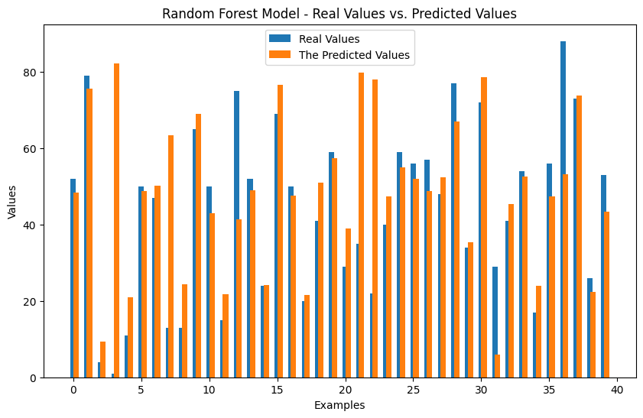
results

Slide 16
Thank you for listening to me.
Halil Kılcı
21501317

